Slide 1
NATIONAL INTEREST NATIONAL POWER
GLOBAL POLITICS: CHAPTER NINE- PAGE 210-234
INTERNATIONAL RELATIONS: CHAPTER TWO-PAGE 45-82

Slide 2
The national interests is a key concept of international relations that encompass the political interests, security interests, economic interests, cultural interests and other interests of a country.
With the state sovereignty at the core, a country's political interests embody the bulk of its national interests with national security being the most fundamental of the national interests.
In Hans Morganthau’s opinion, nation-states’ minimum requirement is to protect their physical, political, and cultural identity against encroachments by other nation-states.

Slide 3
The term ‘national interest’ gained currency only with the emergence of the national state system, increase in popular political control and the great expansion of economic relations.
Hans Morgenthau (1904-1980), a well known proponent of the realist view of IR, was a systematic supporter of the premise that diplomatic strategy should be motivated by national interest rather than by utopian and dangerous, moralistic, legalistic and ideological criteria.
In Morgentha’s view, the minimum requirement of nation-states is to protect their physical, political and cultural identity against encroachments by other nation-states.
From these non-compromising NI, the leaders can derive cooperative and conflictive policies, such as competitive armaments, BoP, foreign aid, alliances, subversion, and economic and psychological warfare.

Slide 4
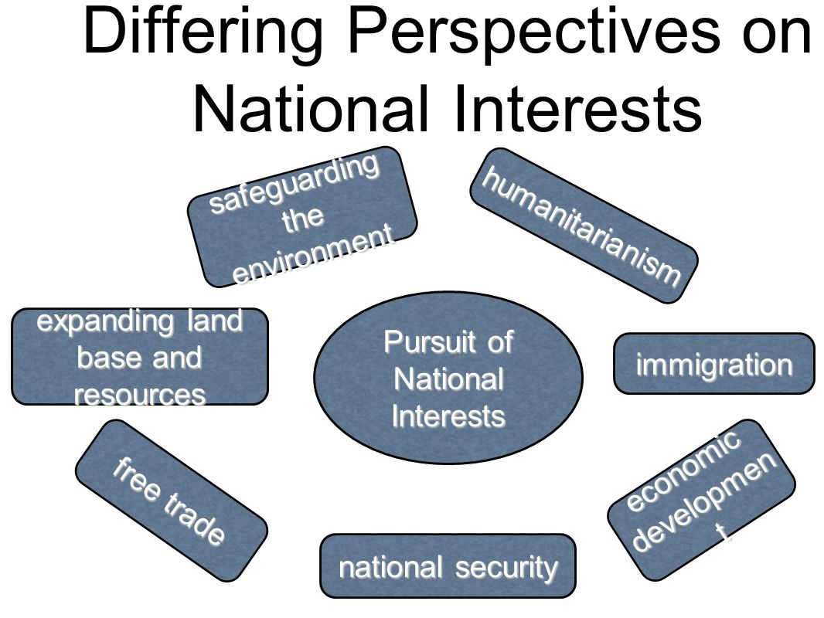

Slide 5
Methods for the Promotion of NI
Coercive Measures (in case of conflicting NI)
Alliances
Diplomatic Negotiations (in case of complementary or compatible national interests)
Economic Aid
Propaganda
Collective Security (international peace and security a common objective of all the nations)

Slide 6
Types of National Interests in International Relations
Economic interests: These can include promoting economic growth, protecting domestic industries, and securing access to natural resources, markets, and other economic opportunities.
National security interests: These can include protecting the country from external threats such as military aggression, terrorism, and cyber attacks, as well as maintaining a strong military and intelligence capabilities.
Political interests: These can include promoting democratic values, protecting human rights, and supporting stable and effective governance within the country and around the world.
Cultural interests: These can include preserving and promoting the country’s cultural heritage, language, and traditions.

Slide 7
Environmental interests: These can include protecting the country’s natural resources and promoting environmental sustainability.
Humanitarian interests: These can include providing assistance to other countries in need, such as in the aftermath of natural disasters or conflicts.
Strategic interests: These can include securing access to key transportation routes, such as sea lanes, or maintaining a presence in key regions of the world.

Slide 8
Classification of National Interests
The Primary Interests:
These are those interests in respect of which no nation can compromise. It includes the preservation of physical, political and cultural identity against possible encroachments by other states. A state has to defend these at all costs.
Secondary Interests:
These are less important than the primary interests. Secondary Interests are quite vital for the existence of the state. This includes the protection of the citizens abroad and ensuring of diplomatic immunities for the diplomatic staff.
Permanent Interests:
These refer to the relatively constant long-term interests of the state. These are subject to very slow changes. The US interest to preserve its spheres of influence and to maintain freedom of navigation in all the oceans is the examples of such interests.

Slide 9
Variable Interests:
Such interests are those interests of a nation which are considered vital for national good in a given set of circumstances. In this sense these can diverge from both primary and permanent interests. The variable interests are largely determined by “the cross currents of personalities, public opinion, sectional interests, partisan politics and political and moral folkways.”
The General Interests:
General interests of a nation refer to those positive conditions which apply to a large number of nations or in several specified fields such as economic, trade, diplomatic relations etc. To maintain international peace is a general interest of all the nations. Similar is the case of disarmament and arms control.
Specific Interests:
These are the logical outgrowths of the general interests and these are defined in terms of time and space. To secure the economic rights of the Third World countries through the securing of a New International Economic Order is a specific interest of India and other developing countries.

Slide 10
Examples
The US presidents have always justified their decisions to go in for the development of more and more destructive weapons in the interest of “US national interest.”
During 1979-89, (erstwhile) USSR justified its intervention in Afghanistan in the name of “Soviet national interests”.
China justified its border disputes with India and the Soviet Union in the name of attempts to secure the national interests of China. Now the P-5 countries talk of Non- proliferation and arms control in terms of the national interests of all the nations.

Slide 11
NATIONAL POWER
Power plays an important role in International relations and it is an essential element of politics. The status of state in the International sphere is determined not by its civilization or culture but by its physical force.
The dictionary meaning of the term power is “that in a person or thing which enables them to act on other persons or things.”
Morgenthau wrote this “when we speak of power, we mean man’s control over the minds and actions of other man”.
Palmer and Perkins observed “To the totality of a states effectiveness in world politics, we apply the term power”.

Slide 12
National power is a relative one. The power of one state is to be measured in comparison with the power of other states. National power is also changing. A nation may be strong today, but tomorrow it may become weak. And the factors of power are inter dependent. This make the measurement of power impossible. We shall conclude with the words of Palmer and Perkins, National power, like nearly everything else in this world of ours, is relative.

Slide 13
VARIOUS FORMS OF POWER
Relational power: The ability of one actor to influence another actor or actors in a manner not of their choosing.
Structural power: The ability to shape the frameworks within which global actors relate to one another, thus affecting 'how things shall be done‘
The knowledge structure, which influences actor’s beliefs, ideas or perceptions
The financial structure, which controls access to credit or investment
The security structure, which shapes defence and strategic issues
The production structure, which affects economic development and prosperity

Slide 14
Hard power
The ability of one actor (usually but not necessarily a state) to influence another through the use of threats or rewards, typically involving military ‘sticks’ or economic ‘carrots’
Soft power
The ability to influence other actors by persuading them to follow or agree to norms and aspirations that produce the desired behavior
Hard power draws on resources such as force, sanctions, payments and bribes, soft power operates largely through culture, political ideals and foreign policies (especially when these are seen to be attractive, legitimate or to possess moral authority)

Slide 15
Hard Power (Punishment, reward) Soft Power (Attraction, identification)
Compulsion- Inducement -Agenda setting- Persuasion
Smart Power (Hard and soft power reinforce one another)

Slide 16
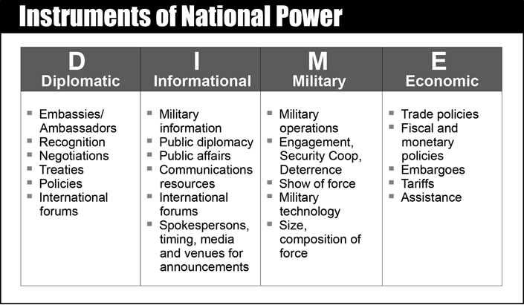

Slide 17
GOBAL POWER STRUCTURES
System polarity refers to the number of blocs of states that exert power in the international system.
Unipolarity (Hegemony)
Unipolarity refers to an international system in which there is one preeminent state, or ‘pole’. In a unipolar system there is but a single great power, implying an absence of constraints or potential rivals. However, as this implies some form of world government, unipolarity is always relative and not absolute.
Unipolarity has been defended on the grounds that the dominant actor is able to act as the ‘world’s police officer’ settling disputes and preventing war (‘Pax Britannicus’ and ‘Pax Americana’) and guaranteeing economic and financial stability by setting and maintaining ground rules for economic behaviour. Critics argue that unipolarity promotes megalomania on the part of the dominant actor, as well as fear, resentment and hostility among other actors

Slide 18
2. Bipolarity
Bipolarity refers to an international system which revolves around two poles (major power blocs). The term is most commonly associated with the Cold War, restricting its use to the dynamics of East–West rivalry during the ‘superpower era’. For a system to be genuinely bipolar a rough equality must occur between the two pre-eminent powers or power blocs, certainly in terms of their military capacity.
Neorealists have argued that this equilibrium implies that bipolar systems are stable and relatively peaceful, being biased in favour of a balance of power.
Liberals, however, have associated bipolarity with tension and insecurity, resulting from their tendency to breed hegemonic ambition and prioritize military power.

Slide 19
3. Multipolarity
Multipolarity refers to an international system in which there are three or more power centers. Neorealists argue that multipolarity creates a bias in favour of fluidity and uncertainty, which can lead only to instability and an increased likelihood of war (‘anarchical’ multipolarity).
Liberals nevertheless argue that multipolar systems are characterized by a tendency towards multilateralism, as a more even division of global power promotes peace, cooperation and integration (‘interdependent’ multipolarity).

Slide 20
Elements of National Power
Morgenthau has divided the elements into two categories- permanent and temporary. Palmer and Perkins has divided the elements into tangible and intangible. Broadlly speaking, the elements of National power are inter-related.
1- Geography: Napolean once said that “The foreign policy of a country is determined by its geography”. Geography has always been a determining factor of the national power of a state. Today states are inter dependent to each other. So geography has its role in the relations of nations. Geography as an element of national power has the following sub elements.

Slide 21
Size (The size of a state, whether small or great, is an important element of national power. But only size does not make a state powerful. Even a small country can exert its influence in International relations very much)
Topography (Topography gives certain advantages and disadvantages to a country. The rivers many provide ports, harbours and advantageous transport system “Strait of Hormuz”. At the same time they may create obstacles in building road, play havoc through floods or can be a source of conflict between two states like Indus river dispute. Mountains cause rain fall, stops enemies etc. Russia is denied by topography access to the open seas.)
Climate (Location, attitudes, rainfall and winds determine climate. Climate has an indirect effect on culture, economy and natural resources, and direct on health and energy of people. Extreme heat and cold are unfavorable for strength)

Slide 22
Location (Diplomacy and war strategy has its impact on location. Nearness to sea will provide for good harbours and it will increase chance of trade. Insular position has its impact on its diplomacy. Great obstacles in the form of mountains etc. will decrease the chance of trade.)
National Boundaries (Boundaries of the states are of two types – natural and artificial. Sea, mountains etc are natural boundaries. The contemporary tension in International relations is due to the boundary disputes. For example Israel- Palestine , Taiwan issue, East China Sea- Senkaku Islands in Japan (China—Japan) or Crimean annexation by Russia. Boundaries often decide the fate of nations.)

Slide 23
2- Natural Resources: Natural resources are the permanent factors of National power. Palmer and Perkins termed it as the Gift of Nature. Perhaps the natural resources are the most important elements of national power. For example, control of oil pipeline routes, especially in Central Asia, is a major geopolitical issue. The following elements constitute natural resources.
a) Food –Stuffs and Agriculture Products :
The countries self sufficient in food stuffs have an advantage over other nations which lack it in times of war, it will become more clear, scarcity of agriculture products limits the of power of a nation.

Slide 24
b) Minerals: For military strength, it is necessary to have highly developed industry, for which minerals are necessary. Possession of minerals will strengthen the industrial capacity of a nation. For example, Petroleum, an important mineral has created ‘Oil Diplomacy’ in the middle East.
3- Population: Prior to 20th century a large population was undoubtedly a significant and important source of national power. But in the 20th century, large population is a source of strength and weakness. It will be strength, if the state has the means to utilize its talent, energy and maintain a proper standard of living.
Economic development, and particularly industrialization, require mass literacy and at least basic levels of work-related skills. As production, distribution and exchange are increasingly dependent on modern technology, higher-level scientific and ICT skills have become a requirement for economic success

Slide 25
4- Technology: Technology is the application of physical and biological sciences to engineering industry and other human activities. The technological advancement is a tremendous element of national power which has influenced the world affairs of recent times by increasing the technique of communications and inter dependence of states. Technology influenced strategic factors. Seas are now no barriers and hence the states separated by the seas do not remain attached to each other in any matter whatsoever. Technology has affected matter of foreign policy.

Slide 26
Now Foreign policy includes the technological assistance. Increased emphasis on arms control, technological intelligence and communication satellites. Technology has sophisticated war methods. New inventions prove that the more technologically advanced is a nation the more is its capacity to influence other nations.
5- Military Preparedness: Military Preparedness requires a military establishment capable of supporting the foreign policies pursued. The significant factors that make military preparedness one are follows.
War technology: The fate of nations and civilization have always been determined by superior armies using sophisticated technology. The less sophisticated technology always has to face defeat.

Slide 27
Leadership: A military leader is the person, who makes best use of available resources in the appropriate time to reap the maximum fruits. Victory and defeat in war is associated with its leader.
Espionage: Today the success of military depends upon affective Espionage. Prior knowledge of enemies move, location and capacity of forces etc will open the way for easy success. The Radar and artificial satellites have played an important role in these filed.
Quality of armed force: Military power is dependent upon the quality of men and arms. Modern developed arms will make the victory sure, Israel’s victory over the Arab states can be cited as an example.

Slide 28
6- Ideologies: Ideology is a body of ideas concerning economic social and political values and goals with positive actions and programme for attaining these goals. The impact of Ideology in International relations is very wide. It has produced a new cohesiveness within nations and group of nations. Even the geographical boundaries fail to limit the extension of ideologies.
Can be said that the role of ideology as an element of national power is not so powerful as in the past?

Slide 29
National Morale: Morale is a healthy frame of mind characterized by fidelity to a cause. In the worlds of Palmer and Perkins, “Morale is a thing of spirit, made up of loyalty, courage faith and the impulse to the preservation of personality and diginity”.
National morale is an important aspect of national power, in the absence of which, the other factors will not work. National morale is not static. There is a point where it breaks. National morale can be manufactured or stimulated by various factors. Factors like National character, culture, popular leadership, popular government and circumstances make national morals.

Slide 30
BALANCE OF POWER
The term balance of power refers to the general concept of one or more states’ power being used to balance that of another state or group of states. Balance of power can refer to any ratio of power capabilities between states or alliances, or it can mean only a relatively equal ratio. Alternatively, balance of power can refer to the process by which counterbalancing coalitions have repeatedly formed in history to prevent one state from conquering an entire region

Slide 31
The theory of balance of power argues that such counterbalancing occurs regularly and maintains the stability of the international system. The system is stable in that its rules and principles stay the same: state sovereignty does not collapse into a universal empire. This stability does not, however, imply peace; it is rather a stability maintained by means of recurring wars that adjust power relations
Alliances play a key role in the balance of power. Building up one’s own capabilities against a rival is a form of power balancing, but forming an alliance against a threatening state is often quicker, cheaper, and more effective. In the Cold War, the USA encircled the USSR with military and political alliances to prevent Soviet territorial expansion

